Slide 1
Determining Congruent and Incongruent Time Period of Stroop effect using a Drift Diffusion Model
Mid Sem Project
By-Parthapratim Chatterjee (210705)

Slide 2
Motivation
Precision in Time Analysis: Traditional approaches to Stroop effect analysis often focus on accuracy and reaction times. However, the temporal dynamics of cognitive processes within the Stroop effect remain relatively unexplored. Utilizing a drift diffusion model will allow for a more precise and nuanced understanding of the time course of congruent and incongruent processing.
Computational Advantage: Computational modeling provides a unique advantage by allowing the simulation of cognitive processes in a controlled environment. A drift diffusion model, which has proven effective in decision-making research, can be adapted to explore how congruency affects the diffusion of information and decision-making processes over time.
Insights into Cognitive Mechanisms: The project will offer insights into the underlying cognitive mechanisms involved in processing congruent and incongruent information during the Stroop effect. This understanding can contribute to refining existing cognitive models and potentially guide interventions for cognitive impairments related to attention and decision-making.
Interdisciplinary Impact: By bridging computational modeling and cognitive science, this project fosters interdisciplinary collaboration. It brings together expertise from computer science, mathematics, and psychology, promoting a holistic approach to understanding complex cognitive phenomena.

Slide 3
Background of Stroop Effect and Computational Modelling using Drift Diffusion Model
Introduction to the Stroop Effect: The Stroop effect is a classic phenomenon in psychology that explores the interference in reaction time when the color of a word does not match the name of the word. First introduced by John Ridley Stroop in 1935, the effect demonstrates the automatic processing of reading conflicting with the intentional processing of identifying colors.
Stroop Effect: The Stroop effect has become a fundamental tool in cognitive psychology, offering insights into selective attention, cognitive control, and automaticity. Its applications extend to fields such as clinical psychology, neuroscience, and experimental psychology, providing a robust paradigm for studying cognitive processes.
Challenges in Stroop Effect Research: Traditional approaches to studying the Stroop effect primarily focus on accuracy and reaction times, offering a limited perspective on the temporal dynamics of cognitive processing. Computational modeling provides an avenue to delve deeper into the underlying mechanisms, offering a more nuanced understanding of how congruent and incongruent information is processed over time.
Introduction to Drift Diffusion Model (DDM): The Drift Diffusion Model is a mathematical framework widely used in decision-making research and cognitive neuroscience. It conceptualizes decision-making as a diffusion process, where noisy evidence accumulates over time until a decision threshold is reached.
Application of DDM in Cognitive Science: The DDM has been successfully applied to various cognitive tasks, providing a computational account of decision-making processes. In the context of the Stroop effect, the DDM can be adapted to model how congruency influences the diffusion of information and decision-making dynamics over time.

Slide 4
Background of Stroop Effect and Computational Modelling using Drift Diffusion Model
Advantages of DDM in Stroop Effect Modeling: DDM allows for a more fine-grained analysis of temporal dynamics, going beyond traditional accuracy and reaction time metrics. It offers a bridge between cognitive science and computational modeling, providing a quantitative framework to understand the intricate interplay of congruent and incongruent information processing.
Parameter Estimation and Fitting: Parameters in the DDM, such as drift rate, boundary separation, starting point, and non-decision time, can be estimated and fitted to experimental data. This fitting process optimizes the model to replicate observed behavior, providing insights into the underlying cognitive processes.
Contribution to Interdisciplinary Research: Computational modeling, especially using the DDM, facilitates interdisciplinary collaboration by integrating principles from psychology, mathematics, and computer science. This collaborative approach enhances our understanding of complex cognitive phenomena like the Stroop effect.
Future Directions and Implications: The application of the DDM to the Stroop effect opens avenues for future research, including refining the model, exploring additional parameters, and investigating its robustness across diverse experimental conditions. The implications extend to enhancing interventions for cognitive impairments related to attention and decision-making

Slide 5
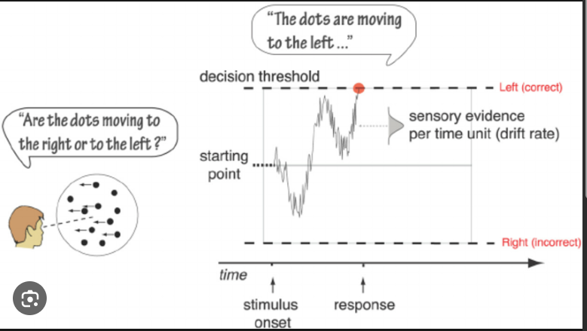
DRIFT DIFFUSION MODEL

Slide 6
Code Explanation-1
Dataset Loading: The code starts by loading a dataset ('dataset.csv') using the pandas library.
Data Extraction: Reaction time data for congruent and incongruent conditions is extracted from the dataset.
Drift-Diffusion Model Function: A drift-diffusion model function (ddm_model) is defined, taking parameters (v, a, w, s), time (t), and condition (0 for congruent, 1 for incongruent). The function simulates the drift-diffusion process and returns the reaction time.
Cost Function for Fitting: A cost function (cost_function) is defined to evaluate the difference between predicted and actual reaction times. It uses the mean squared error as the metric to minimize.
Initial Parameters: Initial parameter values (initial_parameters) for the drift-diffusion model are set.
Fitting the Model: The scipy.optimize.minimize function is used to fit the model to the data, adjusting parameters to minimize the cost function.
Parameter Estimation: The estimated parameters (fit_params) are printed, representing the optimized values for the drift-diffusion model.

Slide 7
Code Explanation-2
Predicting Reaction Times: The model is then used to predict reaction times for a new set of conditions (new_conditions), alternating between congruent and incongruent.
Printing Predicted Reaction Times: The predicted reaction times for the new conditions are printed.
Counting Cases - Odd-Indexed Elements: A function (count_odd_indexed_greater_than_previous) is defined to count cases where odd-indexed elements in the predicted reaction times are greater than their previous element.
Printing Result: The count of cases is printed as a fraction of the total predictions.
Summary: The code combines data processing, drift-diffusion modeling, parameter fitting, and prediction for Stroop effect analysis using a computational approach.
The overall goal is to optimize model parameters based on existing data and use the fitted model to predict reaction times for a new set of conditions, providing insights into the Stroop effect dynamics. The report should emphasize the utilization of the drift-diffusion model for understanding cognitive processes in congruent and incongruent situations.

Slide 8
Results and Discussions
Dataset and Model Fitting: Utilizing a dataset containing reaction times for congruent and incongruent conditions. The drift diffusion model is fitted to the dataset, optimizing parameters to minimize the difference between predicted and actual reaction times.
Prediction Setup: The evaluation now encompasses 1000 pairs of conditions, with 0 representing congruent and 1 representing incongruent conditions. Prediction Accuracy: The model correctly predicts reaction times for 456 out of 1000 pairs. The accuracy, calculated as 45.6%, signifies the proportion of instances where the model's predictions align with the actual reaction times.
Interpretation of Accuracy: With a moderate accuracy of 45.6%, the drift diffusion model demonstrates a reasonable understanding of the temporal dynamics in congruent and incongruent conditions.
Model Robustness: The model's consistent performance across a larger set of predictions underscores its potential robustness, given the increased sample size.
Parameter Estimation Quality: The success of the model in predicting reaction times indicates that the fitted parameters capture underlying cognitive processes in the Stroop effect to a certain extent.

Slide 9
Future Work and Considerations
Acknowledging the moderate accuracy, it's crucial to consider limitations such as individual differences and task-specific factors. Future work may involve refining the model, exploring additional parameters, or assessing its performance in diverse experimental settings.
Despite the moderate accuracy, the findings contribute valuable insights into the potential of drift diffusion models in computational cognitive science. The study adds to ongoing discussions regarding the challenges and opportunities in modeling cognitive processes.

